Slide 1
Dependency Injection in .NET

Slide 2
Objectives
Overview the SOLID Principles
Overview the Inversion of Control (IoC) pattern
Overview the Dependency Injection (DI)
Describe about Service Lifetimes in DI
Describe about Dependency Injection patterns
Describe about Advantages and Disadvantages of DI patterns
Demo about IoC pattern
Demo about DI pattern: Constructor, Property, Method and Ambient Context

Slide 3
Overview The SOLID Principles

Slide 4
Understanding The SOLID Principles
The SOLID principles were developed by Robert C. Martin in a 2000 essay, “Design Principles and Design Patterns,” although the acronym was coined later by Michael Feathers
SOLID is a popular set of design principles that are used in object-oriented software development
SOLID is an acronym that stands for five key design principles: single responsibility principle, open-closed principle, Liskov substitution principle, interface segregation principle, and dependency inversion principle
All five are commonly used by software engineers and provide some important benefits for developers

Slide 5
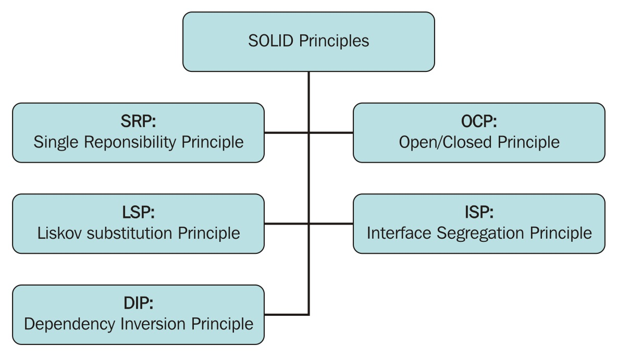
Understanding The SOLID Principles
The following diagram schematizes the five principles' initials and correspondences:

Slide 6
Understanding The SOLID Principles
S - Single Responsibility Principle: A class should have only a single responsibility (that is, only one potential change in the software's specification should be able to affect the specification of the class)
O - Open/Closed Principle: Software entities should be open for extension, but closed for modification
L - Liskov Substitution Principle: Objects in a program should be replaceable with instances of their subtypes without altering the correctness of that program
I - Interface Segregation Principle: Many client-specific interfaces are better than one general-purpose interface
D - Dependency Inversion Principle:
High-level modules should not depend on low-level modules. Both should depend on abstractions
Abstractions should not depend upon details. Details should depend upon abstractions

Slide 7
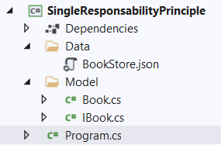
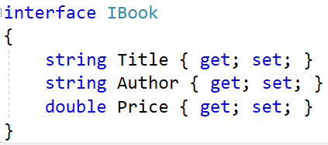
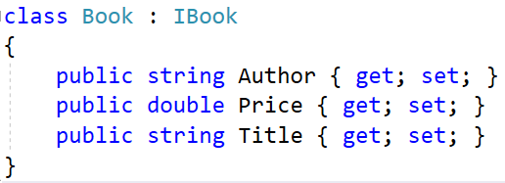
Single Responsibility Principle Demo
[
{
"Title": "Mastering C# and .NET Programming",
"Author": "Marino Posadas",
"Price": 49.89
},
{
"Title": "F# Programming",
"Author": "Apress",
"Price": 33.91
}
]
1
2
3

Slide 8
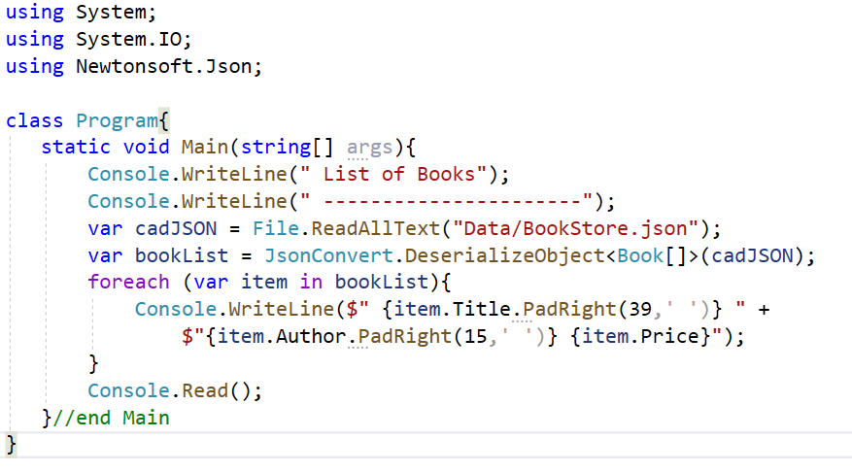
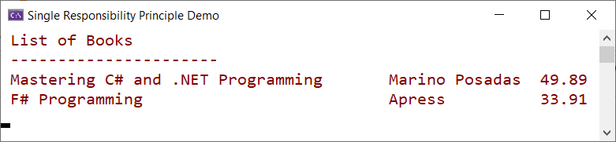
Single Responsibility Principle Demo
4
Install Newtonsoft.Json package from NuGet
5
Program.cs
6

Slide 9
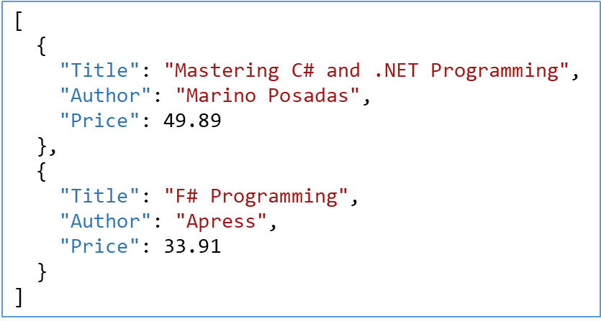
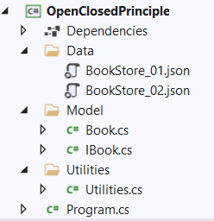
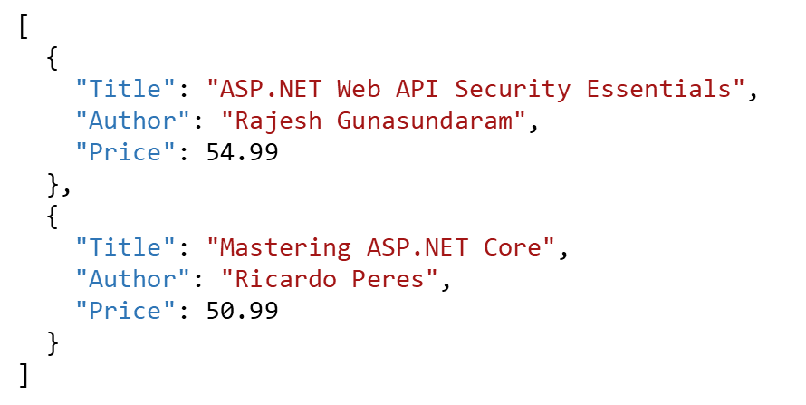
Open/Closed Principle Demo
1
2
3
4

Slide 10
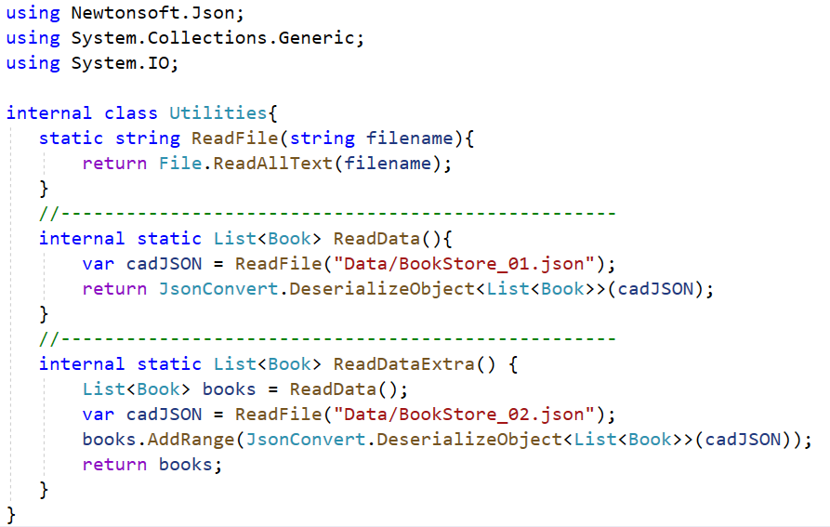
Open/Closed Principle Demo
5

Slide 11
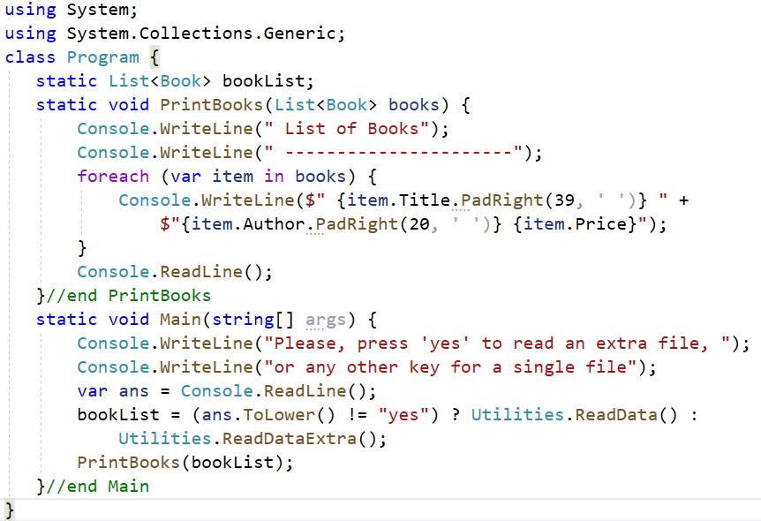
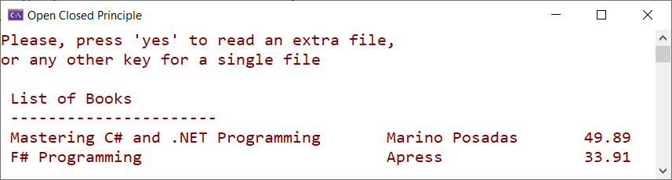
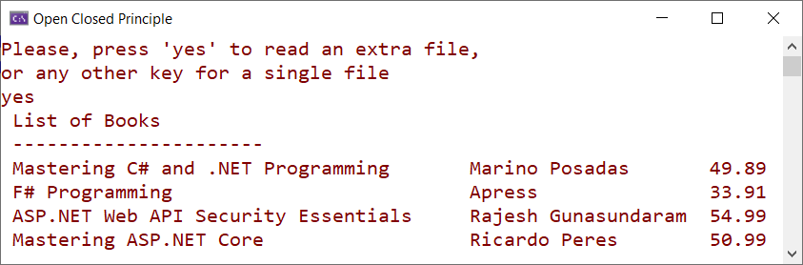
Open/Closed Principle Demo
6
Program.cs
7
8

Slide 12
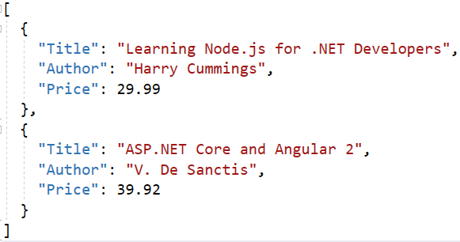
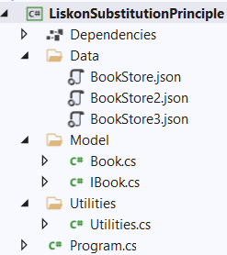
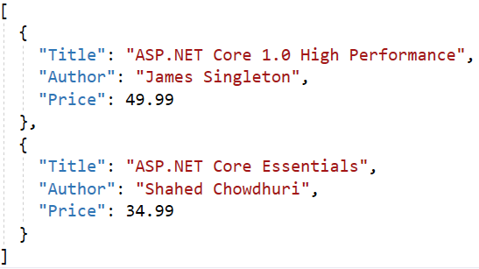
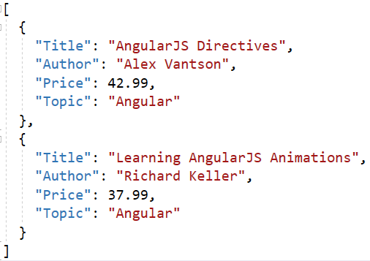
Liskov Substitution Principle Demo

Slide 13
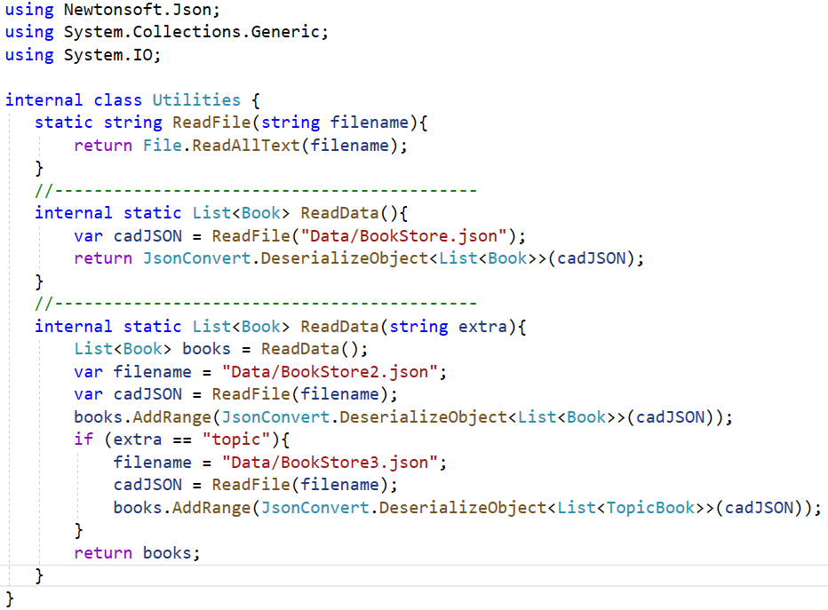
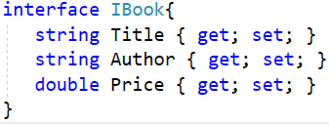
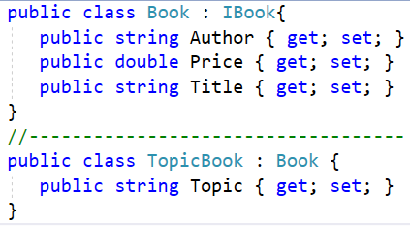
Liskov Substitution Principle Demo
IBook.cs
Utilities.cs
Book.cs

Slide 14
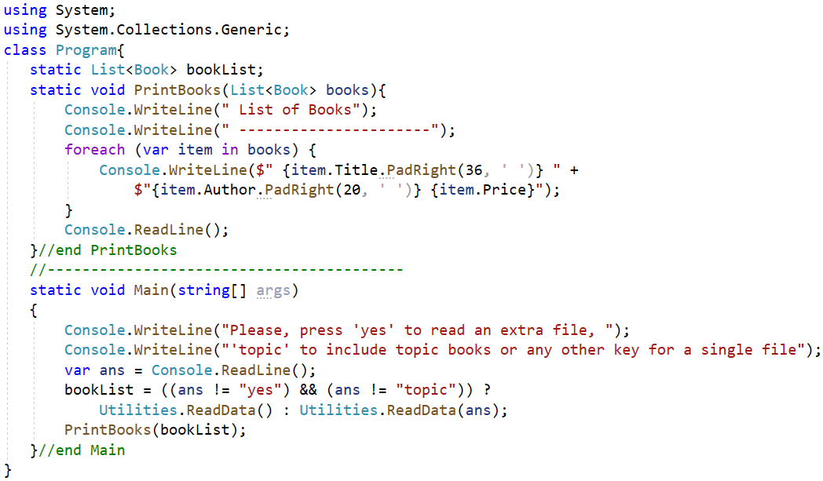
Liskov Substitution Principle Demo
Program.cs

Slide 15
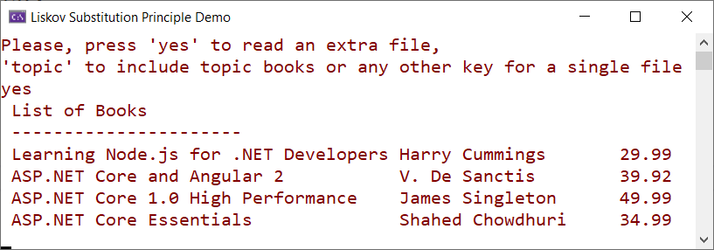

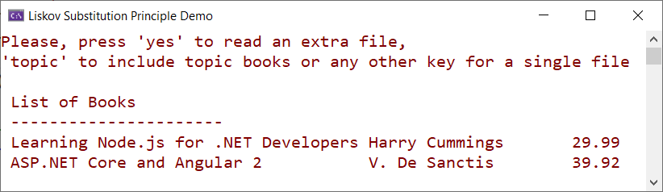
Liskov Substitution Principle Demo

Slide 16
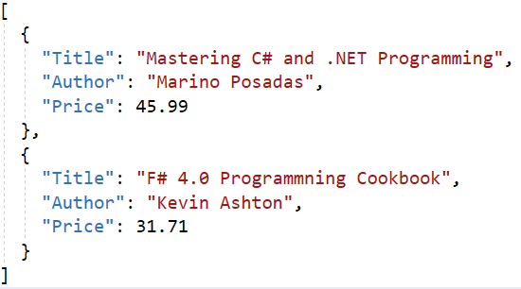
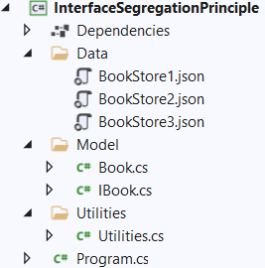
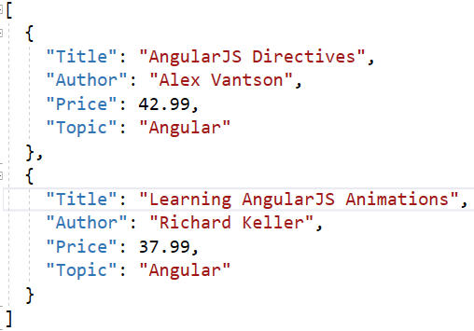
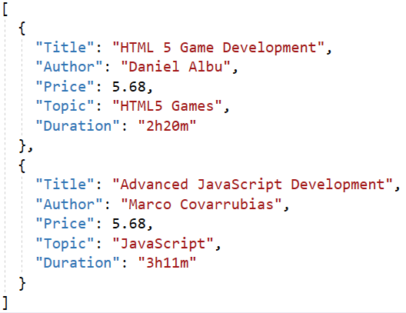
Interface Segregation Principle Demo

Slide 17
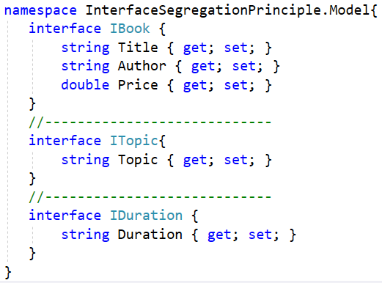
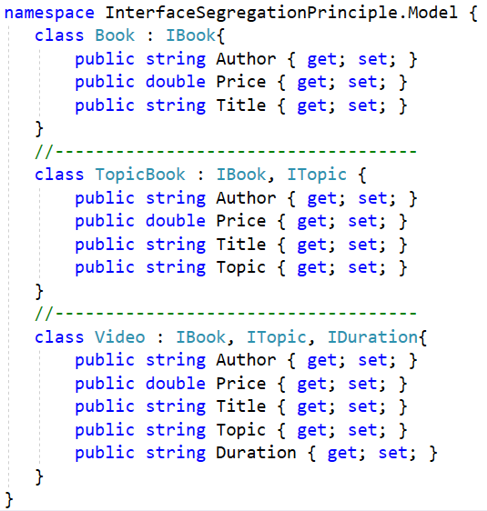
Interface Segregation Principle Demo

Slide 18
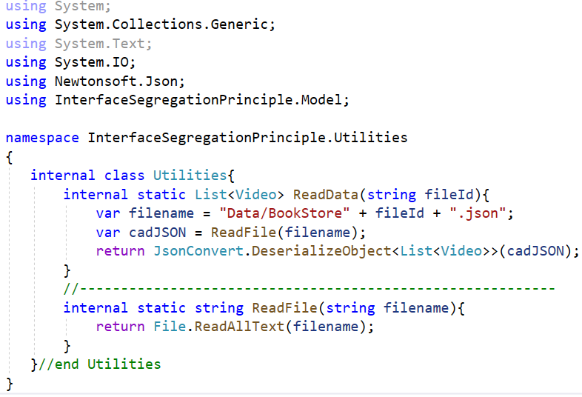
Interface Segregation Principle Demo

Slide 19
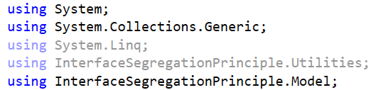
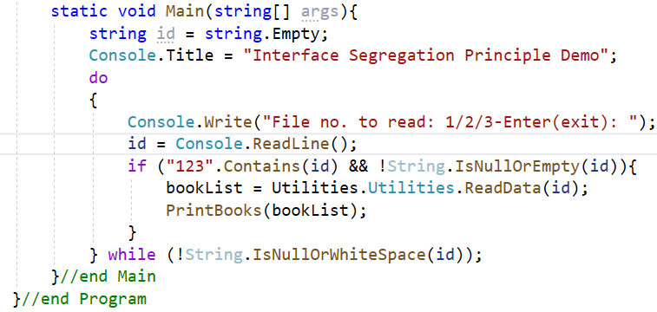
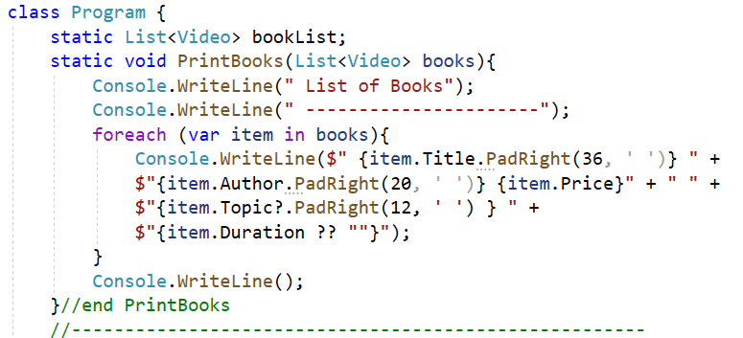
Interface Segregation Principle Demo
Program.cs

Slide 20
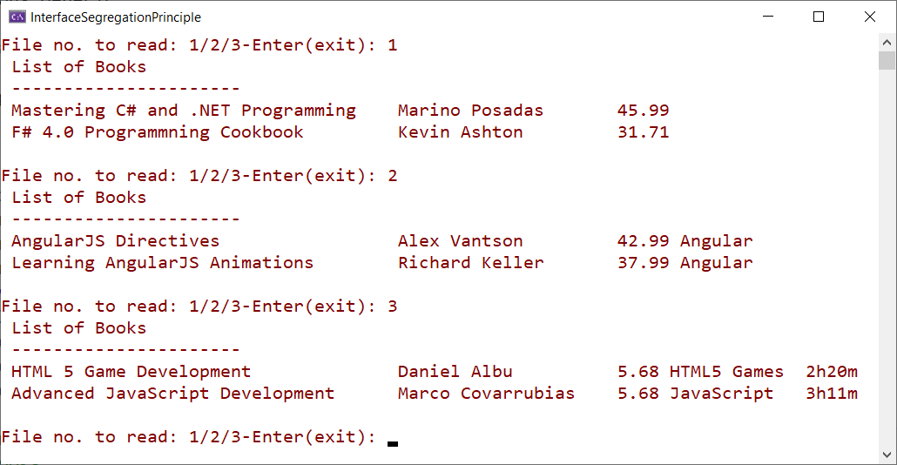
Interface Segregation Principle Demo

Slide 21
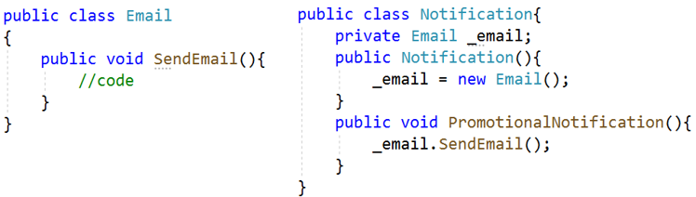
Dependency Inversion Principle (DIP)
High-level modules should not depend on low-level modules. Both should depend on the abstraction
Abstractions should not depend on details. Details should depend on abstractions
Notification depends on Email, creating an instance in its constructor. This kind of interaction is said to be tightly coupled. If we want to send other types of notification as well, we have to modify the way the Notification class is implemented

Slide 22
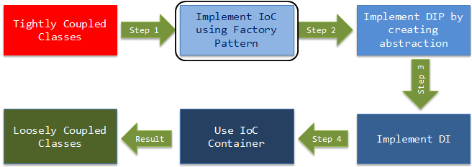
Understanding Inversion of Control (IoC)
Inversion of Control (IoC) is a design principle. As the name suggests, it is used to invert different kinds of controls in object-oriented design to achieve loose coupling
The controls refer to any additional responsibilities a class has, other than its main responsibility. This include control over the flow of an application, and control over the flow of an object creation or dependent object creation and binding
The IoC principle helps in designing loosely coupled classes which make them testable, maintainable and extensible
The DIP is a principle or set of rules kind of theory. On the other hand, Inversion of Control is a pattern of well-defined steps we can follow to make our code DIP friendly

Slide 23
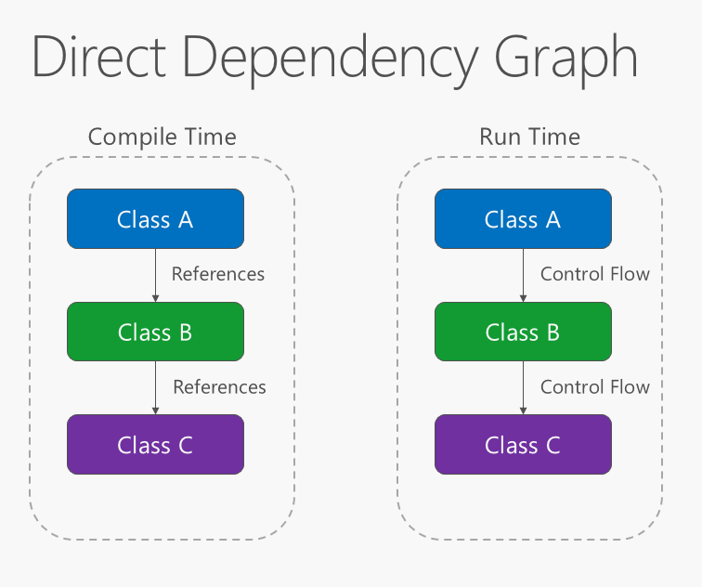
Understanding Inversion of Control (IoC)
The direction of dependency within the application should be in the direction of abstraction, not implementation details. Most applications are written such that compile-time dependency flows in the direction of runtime execution, producing a direct dependency graph
That is, if class A calls a method of class B and class B calls a method of class C, then at compile time class A will depend on class B, and class B will depend on class C, as shown in the figure

Slide 24
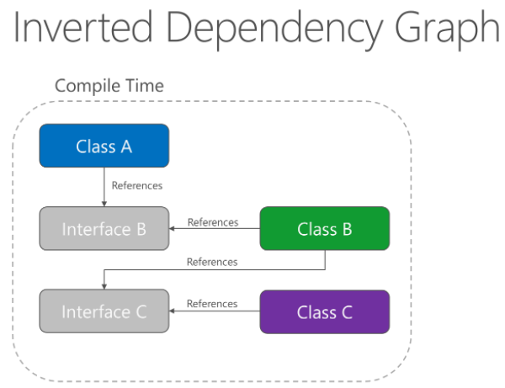
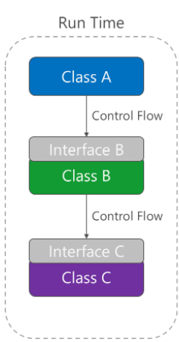
Understanding Inversion of Control (IoC)
Applying the Dependency Inversion Principle (DIP) allows A to call methods on an abstraction that B implements, making it possible for A to call B at runtime, but for B to depend on an interface controlled by A at compile time (thus, inverting the typical compile-time dependency)
At run time, the flow of program execution remains unchanged, but the introduction of interfaces means that different implementations of these interfaces can easily be plugged in

Slide 25
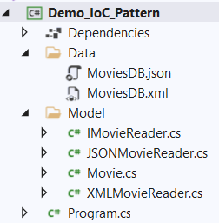
IoC Pattern Demo
[
{
"ID": "1",
"Title": "Jurassic Park",
"OscarNominations": "3",
"OscarWins": "3"
},
{
"ID": "2",
"Title": "Spider-Man",
"OscarNominations": "2",
"OscarWins": "0"
}
]
<Movies>
<Movie>
<ID>3</ID>
<Title>King Kong</Title>
<OscarNominations>4</OscarNominations>
<OscarWins>3</OscarWins>
</Movie>
<Movie>
<ID>5</ID>
<Title>Superman Returns</Title>
<OscarNominations>1</OscarNominations>
<OscarWins>0</OscarWins>
</Movie>
</Movies>

Slide 26
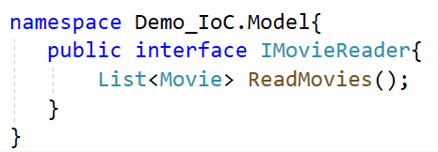
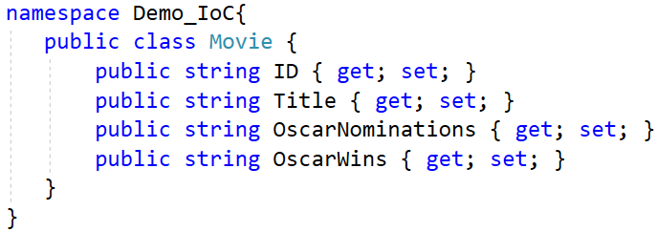
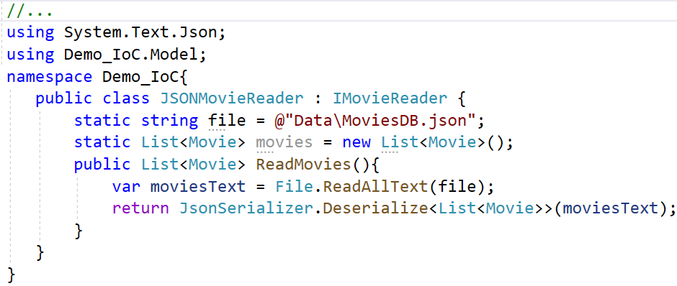
IoC Pattern Demo

Slide 27
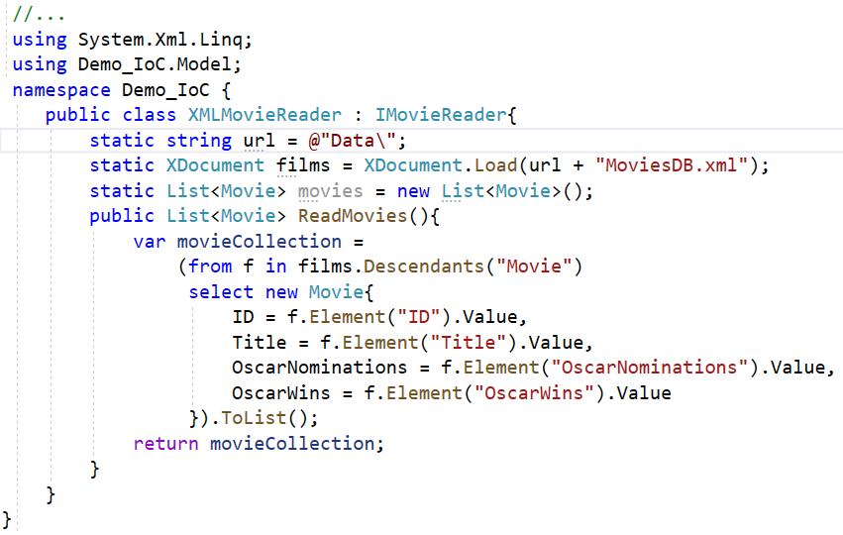
IoC Pattern Demo

Slide 28
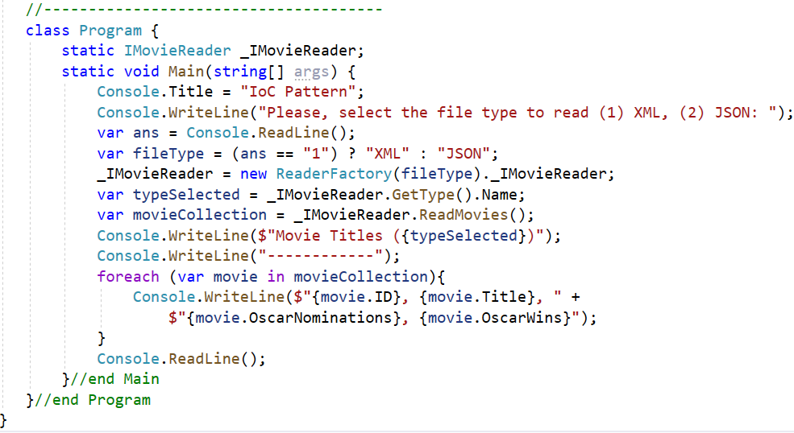
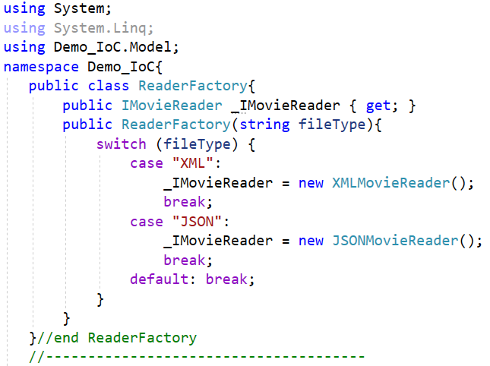
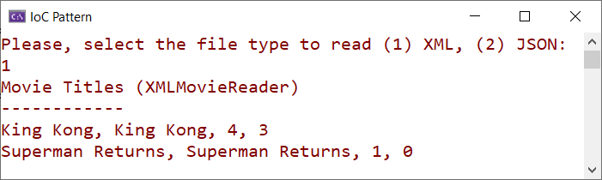
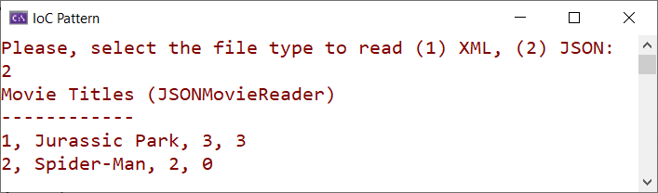
IoC Pattern Demo
Program.cs

Slide 29
Overview Dependency Injection

Slide 30
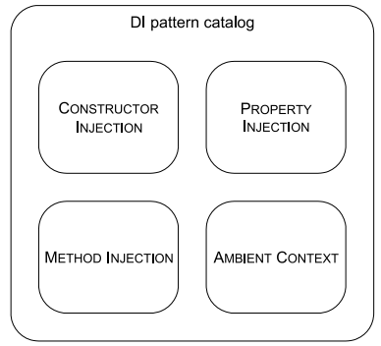
Understanding Dependency Injection (DI)
IoC can be done using Dependency Injection (DI). It explains how to inject the concrete implementation into a class that is using abstraction, in other words an interface inside
The main idea of dependency injection is to reduce the coupling between classes and move the binding of abstraction and concrete implementation out of the dependent class. In simple words, DI is how one object know about other dependent object which is abstracted. There are mainly 04 ways of achieving the Dependency Injection:

Slide 31
Benefits of Dependency Injection (DI)
Benefit | Description | When is it valuable?
Late binding | Services can be swapped with other services | Valuable in standard software, but perhaps less so in enterprise applications where the runtime environment tends to be well-defined
Extensibility | Code can be extended and reused in ways not explicitly planned for | Always valuable
Parallel development | Code can be developed in parallel | Valuable in large, complex applications; not so much in small, simple applications
Maintainability | Classes with clearly defined responsibilities are easier to maintain | Always valuable
Testability | Classes can be unit tested | Only valuable if you unit test (which you really, really should)

Slide 32
Dependency Injection in .NET (.NET Core)
We can implement Dependency Injection manually by using one or more of the patterns. However, .NET Core comes with a built-in DI Container that simplifies Dependency Injection management
A DI Container is a software library that can automate many of the tasks involved in composing objects and managing their lifetimes
The DI Container is responsible for supporting automatic Dependency Injection. Its basic features include:
Registration: the IoC Container needs to know which type of object to create for a specific dependency; so, it provides a way to map a type to a class so that it can create the correct dependency instance
Resolution: this feature allows the IoC Container to resolve a dependency by creating an object and injecting it into the requesting class
Disposition: the IoC Container manages the lifetime of the dependencies following specific criteria

Slide 33
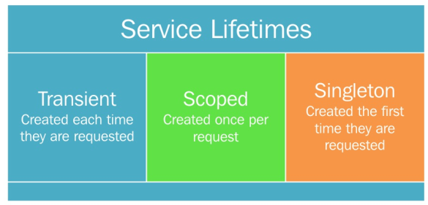
Service Lifetimes
When dealing with an object's lifetime, .NET Core presents three types, depending on the way instances will be configured and used: Singleton, Scoped, and Transient
The Singleton option, a unique instance of the object is used (meaning that we only manage a reference to the object). Any further request uses the same instance, according to the singleton pattern
The Scoped version is local to the context in which it is used and doesn't extend beyond that context
The Transient option creates a new instance of the class every time is requested

Slide 34
The Microsoft.Extensions.DependencyInject Container
NET Core offers its own container linked to the external library Microsoft.Extensions.DependencyInjection (now, in version 5.0), we'll have to reference it via NuGet packages to implement DI in the .NET applications
The following table describes some of the key classes:
Class | Description
ActivatorUtilities | Helper code for the various activator services
DefaultServiceProviderFactory | Default implementation of IServiceProviderFactory<TContainerBuilder>
ServiceCollection | Default implementation of IServiceCollection
ServiceProviderOptions | Options for configuring various behaviors of the default IServiceProvider implementation
HttpClientBuilderExtensions | Extension methods for configuring an IHttpClientBuilder
HttpClientFactoryServiceCollectionExtensions | Extensions methods to configure an IServiceCollection for IHttpClientFactory

Slide 35



ServiceCollection Class Demo
Install package from NuGet

Slide 36




ServiceCollection Class Demo
Program.cs

Slide 37
Understanding Dependency Injection Patterns
The following are the four important patterns by which we can implement Dependency Injection (DI):

Slide 38

DI - Constructor Injection Pattern
How do we guarantee that a necessary dependency is always available to the class we’re currently developing?
By requiring all callers to supply the dependency as a parameter to the class’s constructor
NeedyClass needs an instance of Dependency to work, so it requires any Client to supply an instance via its constructor. This guarantees that the instance is available to NeedyClass whenever it’s needed
When a class requires an instance of a dependency to work at all, we can supply that dependency through the class’s constructor, enabling it to store the reference for future (or immediate) use

Slide 39



DI - Constructor Injection Pattern Demo

Slide 40



DI - Constructor Injection Pattern Demo
Program.cs

Slide 41
DI - Constructor Injection Pattern
Advantages of the Constructor Injection pattern
This is the most preferable way of respecting the concept of DI. Most DI containers target the constructors. It is also the most common and more widely used pattern for DI. The injected component can be used anywhere in the class because when we create the object, the injected dependency comes into the class automatically and stays in some variable
Developers prefer this technique when classes require some external dependency to initiate all other operations. As a constructor is involved, an object becomes ready with the dependent object once it is instantiated
Disadvantages of the Constructor Injection pattern
This is not so easy to implement when the class contains many constructors. Moreover, when the number of dependencies increases for a class, updating the constructor each time is not a feasible task
When we have a number of arguments for a constructor by adding the dependency ones with the existing ones, the class will look messy

Slide 42


DI - Property Injection Pattern
How do we enable DI as an option in a class?
By exposing a writable property that lets callers supply a dependency if they wish to
override the default behavior
SomeClass has an optional DEPENDENCY on ISomeInterface; instead of requiring callers to supply an instance, it’s giving callers an option to define it via a property
The diagram depicts one property EmployeeDept, which can be injected directly with an IDepartment implementation

Slide 43



DI - Property Injection Pattern Demo

Slide 44


DI - Property Injection Pattern Demo
Program.cs

Slide 45
DI - Property Injection Pattern
Advantages of the Property Injection pattern
It does not require adding a new constructor or modifying an existing constructor
This pattern comes in handy if the class has multiple dependencies of different types
Disadvantages of the Property Injection pattern
Setters are not easy to identify in a particular design to inject some external dependency. Still, they are preferred in some situations. However, we should be careful while using the property which is injected because that might be null. There should be an extra check for null, everywhere where you want to use it
Property Injection is considered as bad practice in most of the cases because it hides the dependencies. When the class is instantiated, there is no guarantee that the dependency object will be available for the class to do any operation, unlike Constructor Injection, where the dependency makes its way through during instantiation itself

Slide 46

DI - Method Injection Pattern
How can we inject a Dependency into a class when it’s different for each operation?
By supplying it as a method parameter
A Client creates an instance of SomeClass, but first injects an instance of the DEPENDENCY ISomeInterface with each method call
When a dependency can vary with each method call, we can supply it via a method parameter
Advantages : Allows the caller to provide operation-specific context
Disadvantages: Limited applicability

Slide 47



DI - Method Injection Pattern Demo
Install package from NuGet

Slide 48



DI - Method Injection Pattern Demo
Program.cs

Slide 49


DI - Ambient Context
How can we make a Dependency available to every module without polluting every API with Cross-Cutting Concerns?
By making it available via a static accessor
Every module can access an Ambient Context if it needs to

Slide 50

DI - Ambient Context Demo

Slide 51

DI - Ambient Context Demo

Slide 52



DI - Ambient Context
Program.cs

Slide 53
DI - Ambient Context
Advantages of the Ambient Context
Ambient Context is definitely a savior when an app demands the same dependency multiple times during the app execution. It's very hard to realise the fact that while we write codes for injecting dependencies, there are many such instances of asking the same dependency repeatedly within the app. This is the time where we should take the help of the Ambient Context Pattern, and with just a simple static accessor, we will be able to get the dependency. This not only reduces code but also imposes the DRY principle
Disadvantages of the Ambient Context
Ambient Context is not easy to implement and needs careful attention while using it. By just looking at a class, we can't tell whether it implements the Ambient Context Pattern or not. If the context changes in between execution, the outcome will be different, resulting in side effects

Slide 54
Summary
Concepts were introduced:
Overview the SOLID Principles
Overview the Inversion of Control (IoC) pattern
Overview the Dependency Injection (DI)
Describe about Service Lifetimes in DI
Describe about Dependency Injection patterns
Describe about Advantages and Disadvantages of DI pattern
Demo about IoC pattern
Demo about DI pattern: Constructor, Property, Method and Ambient Context

